Slide 1
CSCI490-Senior Presentation
Rozan Youssef El Majzoub
Dr. Walid Amer
LIU-Department of Computer Science
Notes:
ID=d924773e-9a16-4d6d-9803-8cb819e99682
Recipe=text_billboard
Type=TextOnly
Variant=0
FamilyID=AccentBoxWalbaum_Zero

Slide 2

Introduction
My project, Class & Tech, is an online e-commerce website designed to give users a simple, fast, and reliable way to browse and purchase. Customers nowadays prefer to shop online for convenience and variety. In this way, we achieve what attracts all ages, we combine the convenience of online shopping with the experience of physical store.

Slide 3
Objectives
Create the e-commerce website
Provide secure login and registration
Enable users to browse, search, and filter phones and accessories
Add to shopping cart and checkout system
Build an easy, user-friendly design

Slide 4
Technologies Used
Frontend: HTML, CSS, JavaScript, AJAX
Backend: PHP
Database: MySQL
Design framework: Bootstrap/Tailwind CSS
IDE: visual studio code

Slide 5
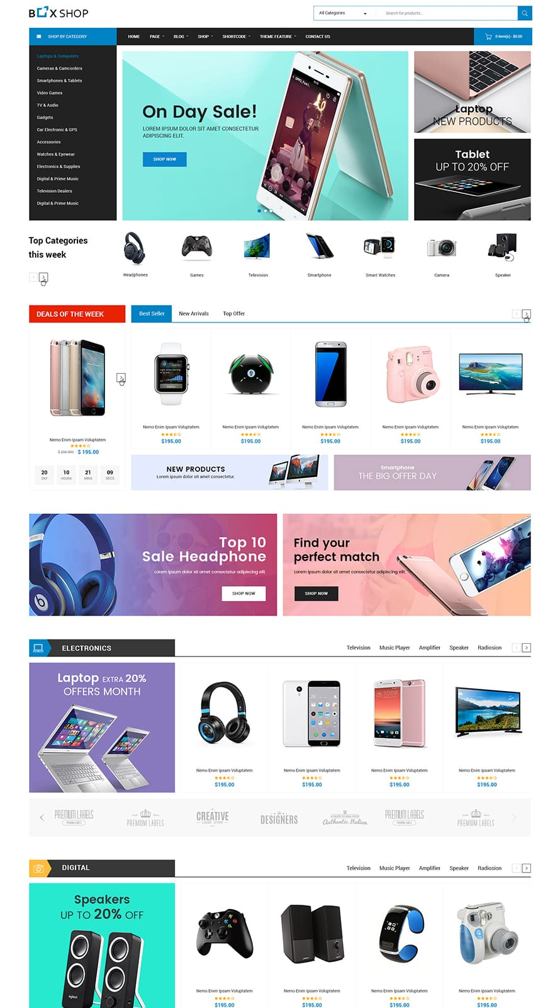
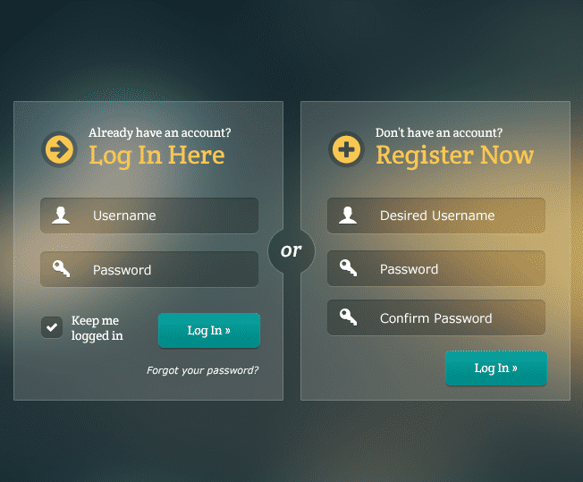
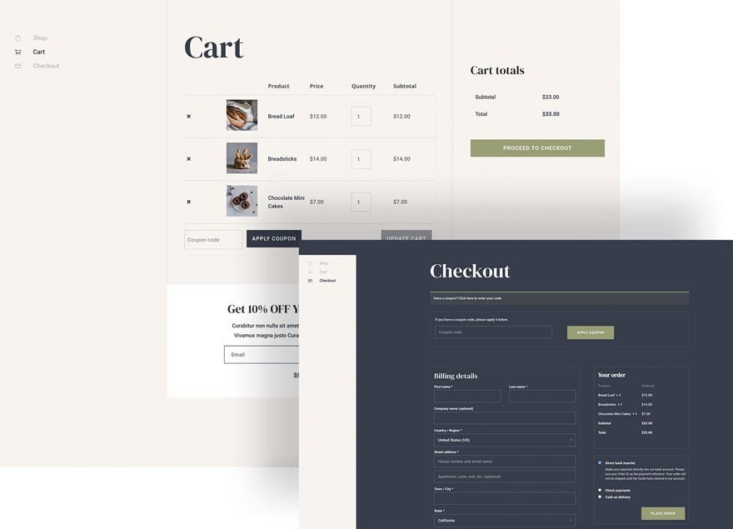
Story Board
Homepage with logo and products listing
Products details page
Login & register forms
Cart & checkout page

Slide 6
ERD
Brand
1
places
brand_id(pk)
name
logo
User
N
makes
1
users_id(pk)
email(unique)
name
number
password
address
type
Payment
1
N
has
1
N
produces
payment_id(pk) payment_method(
whish/cash on delivery)
payment-status transaction-date
Product
Review
1
product_id(pk)
name
description
price
stock-quantity
review_id (pk) rating(1-5)
comment review_date
Order
1
order_id(pk) order_date
status
total-amount
owns
N
1
has
1
1
N
has
Cart
Shipping
N
N
N
M
cart_id(pk)
created-at
supply
has
include
shipping_id(pk) shipping-address tracking-number shipping-status delivery-name
delivery-number
M
M
1
apply
Supplier
Category
Discount
1
supplier_id(pk)
supplier-name contact-info address
category_id(pk)
name
discount_id(pk)
code
discount-percentage
start-date
end-date status(active/inactive)
M
N
contain

Slide 7
DB Tables
User: users_id (PK), name, email (unique), number, password, address, type
Product: product_id (PK), name, brand_id (FK->Brand), category_id (FK->Category), description, price, stock-quantity, supplier_id (FK->Supplier)
Category: category_id(PK), name
Brand: brand_id(PK), name, logo
Cart: cart_id(PK), users_id (FK->User), created-at
Review: review_id (pk), users_id(FK->User), product_id(FK->Products), rating(1-5), comment, review_date
Order: order_id(PK), users_id(FK->User), order_date, status, total-amount, discount_id (FK->Discount, null)
OrderDetails: order_details_id(PK), order_id(FK->Order), product_id(FK->Product), quantity, price
Payment: payment_id(PK), order_id(FK->Order), payment_method(whish/cash on delivery), payment-status, transaction-date
Supplier: supplier_id(PK), supplier-name, contact-info, address
Discount: discount_id(pk), code, discount-percentage, start-date, end-date, status(active/inactive)
Shipping: shipping_id(PK), order_id(FK->Order), shipping-address, tracking-number, shipping-status, delivery-name, delivery-number
Cart-items: cart_items_id(PK), cart_id(FK->Cart), product_id(FK->Product), quantity
SupplyItems: supply_items_id(pk), supplier_id(fk->Supplier), product_id(fk->Product), quantity, price
NOTE: when creating the db tables M:N relations become also tables so that the tables here increased into 14

Slide 8
Future Work
Develop AI-based recommendations
Create a mobile application version for Android and iOS

Slide 9
Challenges
Designing a responsive layout for all devices
1
Handling ajax features without page reload errors
2

Slide 10

For your attention!

